Slide 1
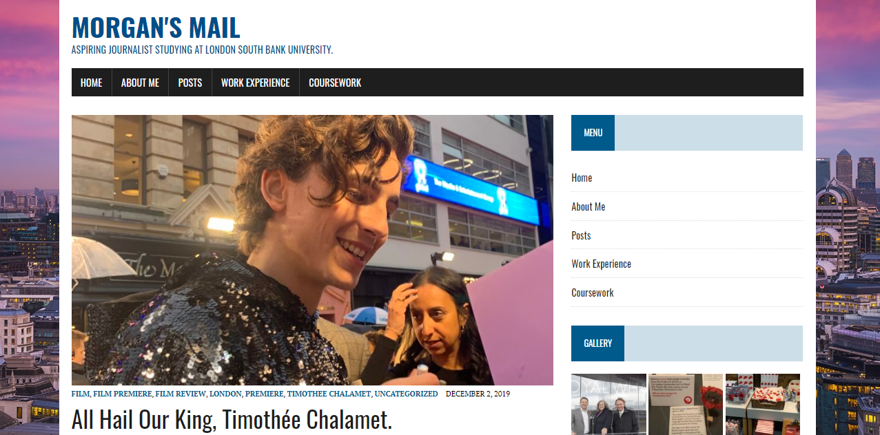
Morgan’s mail
My website presentation.

Slide 2
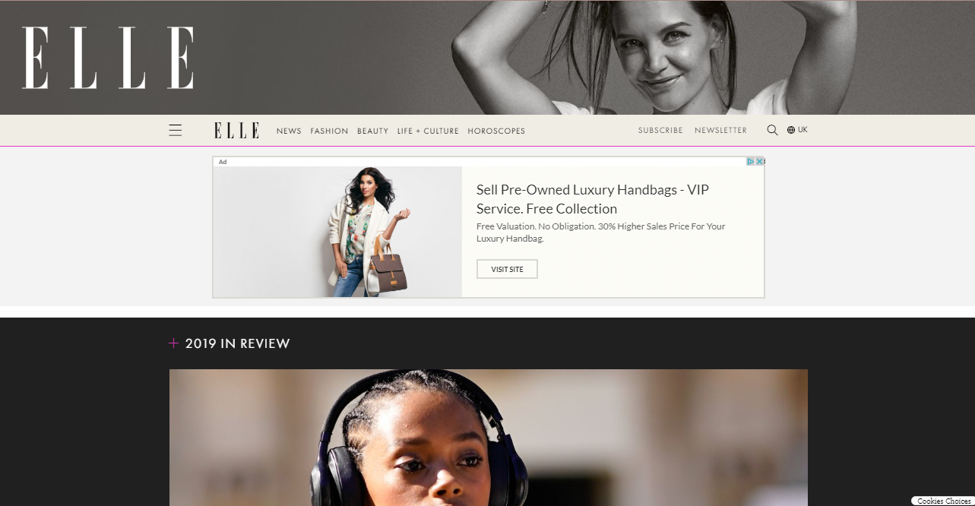
INSPIRATION
I took inspiration from the ELLE magazine website as I like the aesthetic of the website and how the layout is simply and easy to navigate.
I also like their colour scheme as it fits their target audience perfectly of young women which helped me to chose the colour scheme to use for my website as I would like to appeal people who are like me and are interested in the same things that I am.
I chose my theme MH Newsdesk Light as it has a similar menu navigation as the ELLE website. I like this because it makes the menu easy to use but also makes it a feature part of the homepage.
I like that the ELLE website has central images for the main articles and less important stories to the right, so I tried to match this with my website by adding sidebars.

Slide 3
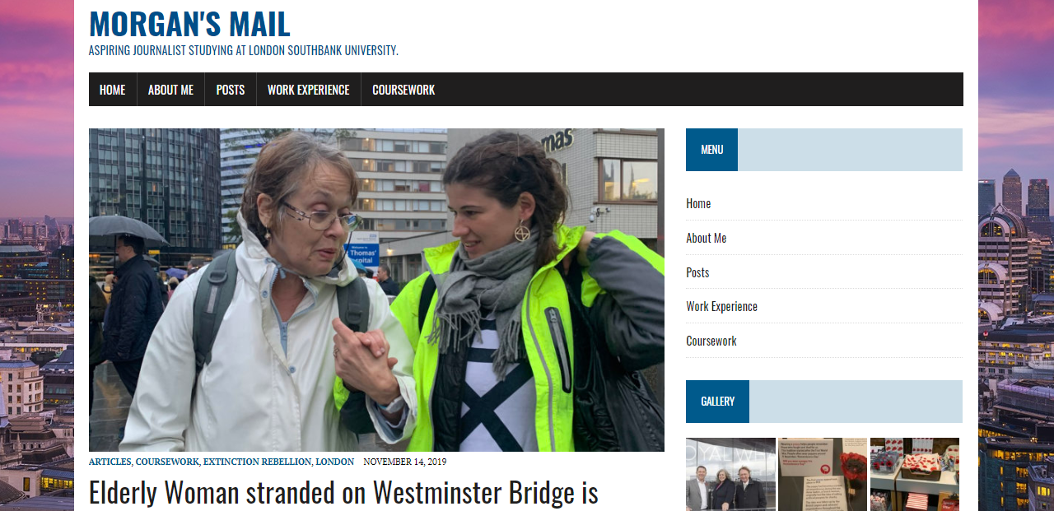
BACKGROUND & theme
I chose this background image because the stories that I intend to write and upload to my website are mostly based in London.
I decided to use this photograph as my background as I thought that it was quite a unique photo of the capital due to the bright colours.
This photograph caught my eye as I thought that it matched with the colour scheme of my website but also the bright colours reflect ideas of positivity. I thought that this was fitting as I aim to make my website a positive place.
The theme that I chose is MH Newsdesk Light because I thought that this theme was the best fitting for the type of news that I want to cover as it is formal but isn’t too intimidating as it is still easy to navigate and has central images on the home page which seem welcoming.
I chose against adding a logo to my website as I thought that it looked too busy when I attempted it.

Slide 4
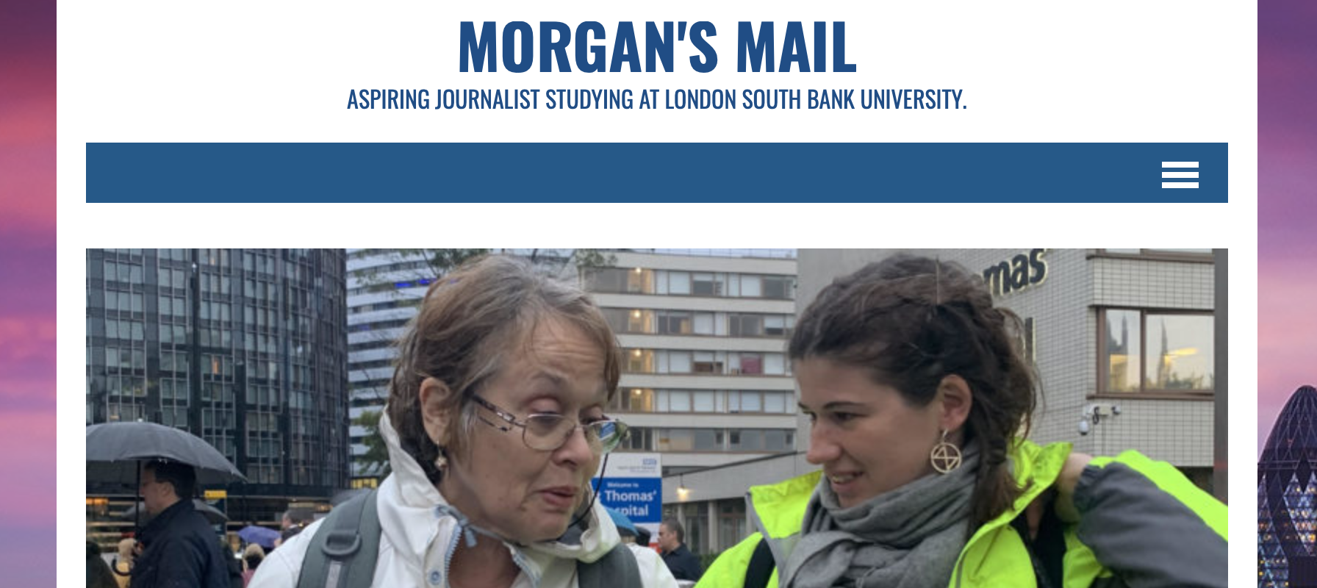
Name AND TAGLINE
Morgan’s Mail:
I chose the name ‘Morgan’s Mail’ as I feel that the use of alliteration gives it a catchy ring.
I used my own name to try and make the website personal to me as I want the website to seem friendly and the word ‘Mail’ helps to portray the website more seriously.
Tagline:
The tagline is used to show that I am a student journalist studying here at London South Bank University.

Slide 5
MENU
My Menu can be found at the top of every page on my website and along the right-hand side on my sidebar.
The Menu is used to help my audience navigate my website easily through the buttons taking you to the different pages on my website.
The Home button takes you back to the start homepage of my website.
The About Me button takes you to the About Me page which has a brief introduction into who I am and where my contact information can be found.
The Posts button takes you to a page where I have linked my uploads in reverse chronological order.
The Work Experience button takes you to the work that I have done for the Shropshire Star and the South London Press.
The Coursework button takes you to the work that I have done for my degree.

Slide 6
Sidebar
I have used a plugin called the Theia Sticky Sidebar which is permanently visible whilst scrolling down the website.
The sidebar is on the right-hand side of my site as people read from left to right, this helps to hook the attention of the audience as their eyes would naturally fall on it.
On my sidebar:
I have a menu on my sidebar to allow my audience to easily navigate my website.
I have used a widget on my sidebar called Gallery which shows my media library of photographs that I have used in my uploaded articles, this will catch the attention of my audience as it teases what my stories hold.
I used a widget to display an archive of my stories which shows the months that I have uploaded an article, this will help my audience to find stories from certain times.
I am currently waiting on my Twitter developer account to be approved and when it does, I will add a Twitter RSS widget to my side bar so my audience can see my recent Twitter activity.

Slide 7
Improving my seo
To improve my SEO (search engine optimisation) I found that it helped to add a short key phrase which was rich with keywords as this would help it appear in search engines more frequently.
I added a brief meta description which summed up the article so that the audience are aware of what to expect from the article before they access it.
I also found it helpful to add a feature image so that the audience can engage with the article and understand some of the context before they read the story. The feature image also helps for the article to look professional and appealing for the audience.

Slide 8
Things to IMPROVE
I am currently waiting on Twitter to confirm my professional account so that I can add another widget to display my Twitter feed on the sidebar which I intend to do ASAP.
I aim to add audio clips and link videos to my website so that my website is more engaging, and the audience will be able to interact with the media.
I want to upload stories from different genres such as, film reviews, hard news stories and tabloid celebrity news as it would appeal a different target audience.
I might attempt to add a logo to my website but try and get a basic symbol logo so that my website doesn’t look too busy and intimidating. Currently, I like how my website looks but I might add a logo later.

Slide 9
☺ THANK YOU FOR LISTENING ☺

