Slide 2
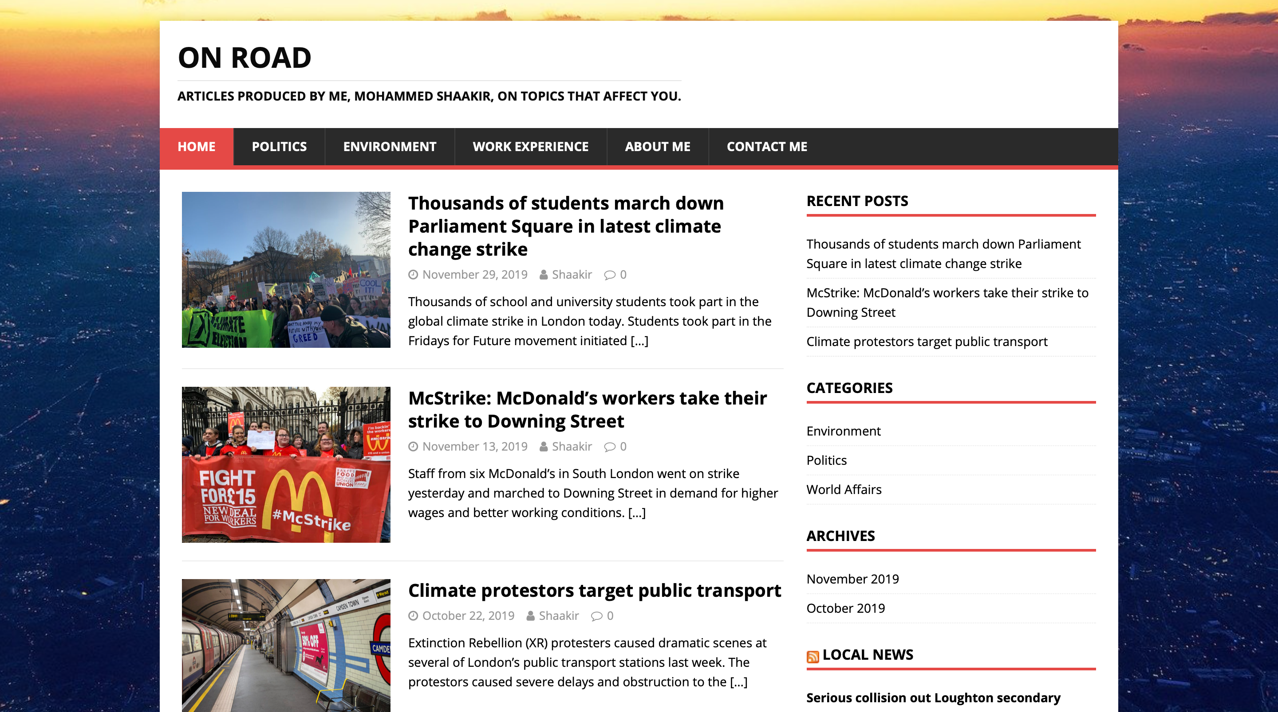
Title and slogan/tagline
Widgets
Background
Theme – MH Magazine Lite
Notes:
Title: reporting stories for the people and focusing on issues that affect them and focusing on issues that are on people’s minds and that are current.
Tagline: short and snappy, I might change it in the future. It gets to the point.
Theme: I chose this theme because it allows you to change colors and allows a lot more flexibility compared to other themes. This theme also is a lot more ‘relaxed’ looking and makes my website seem more approachable to all audiences. Usually websites talking about politics and climate change are addressed to a middle class person but my website is focused on working class people but nevertheless middle class people can visit it. It’s just not as serious and fancy as other websites. The current journalistic landscape is 94% white and 55% male which is why my website is much more approachable because it is supposed to be easy to read and look at and it’s been made in mind of minorities.
The background: is an aerial shot of London because my stories are going to be focused on London. The sunrise adds colour and makes the page standout. It’s also got connotations of a new day and in the future I do intend on uploading articles regularly so my readers can stay up-to-date.
Widgets:
At the top I’ve placed ‘recent posts’ so readers can find latest posts and most recent/relevant info.
Categories – there are only 3 categories which focus on broad topics. My audience is going to come to my website to read on these topics which is why I have put them there and instead of having a scroll tab option I’ve made it a one-click step. I want to increase the categories to health and write about the NHS etc.
Archives - as my website grows this will make it easier for audiences to find articles from specific times relating to specific topics.

Slide 3
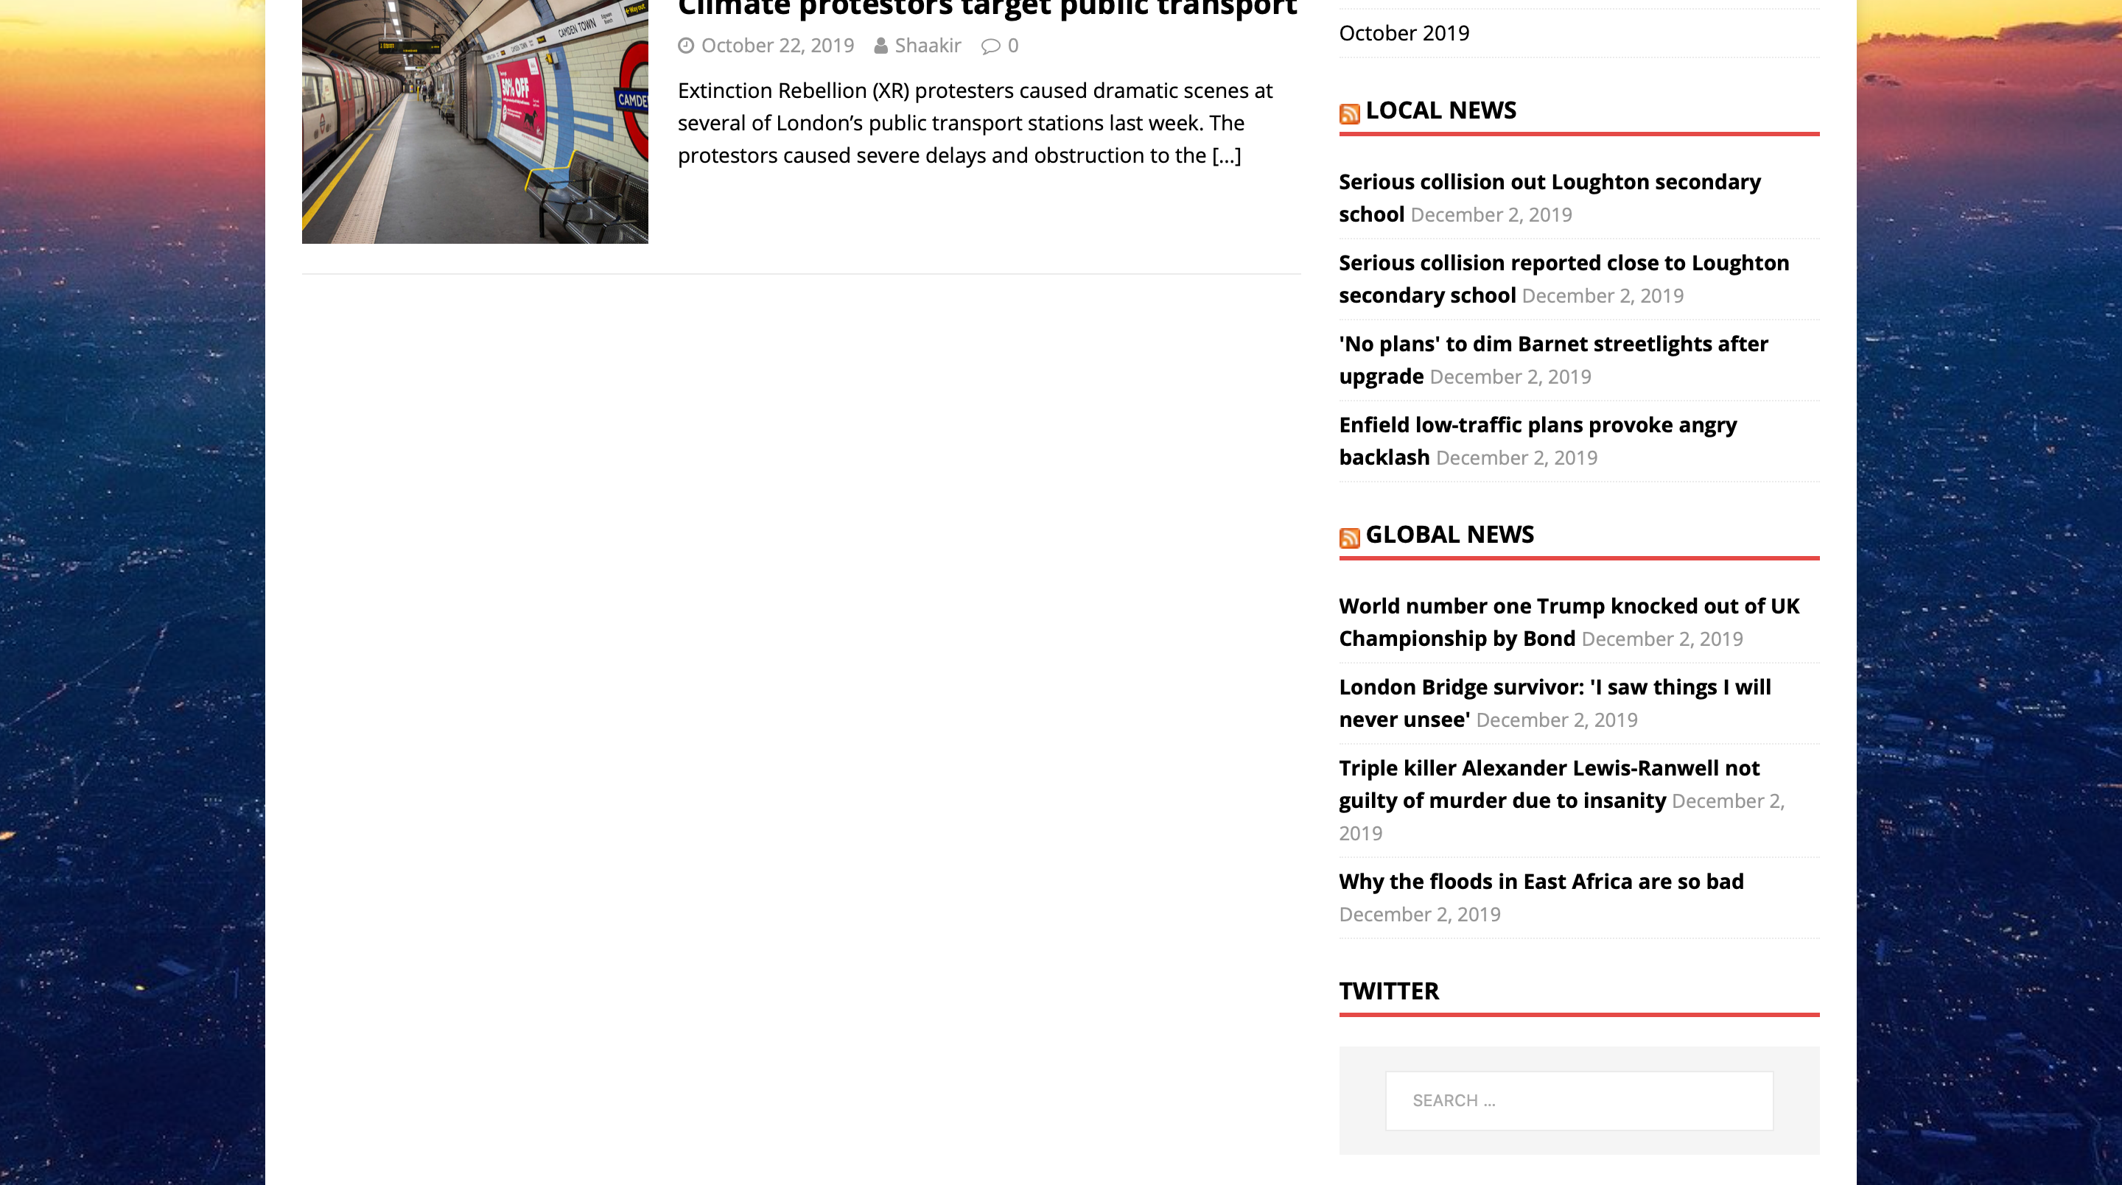
Title and slogan/tagline
Menu
Widgets
Background
Theme – MH Magazine Lite
Notes:
Widgets (continued):
I created a widget for Twitter with Vanessa but for some reason my website doesn’t let me use it which is why the Twitter widget is currently empty.
Local News – I’ve put this RSS feed up so my audience can know more about the top news stories around London and so my website offers more than just articles and has more functions.
Global News: I’ve also got an RSS feed of BBC News so readers know what’s happening on a global scale. Once again, increase functionality.
Menu bar: The menu bar consists of three pages (Home, About Me and Contact Me) of which the last 2 are static. And then there’s 3 categories (politics, environment and work experience). The categories are placed up there so it’s easier to navigate and find what you’re looking for.

Slide 4
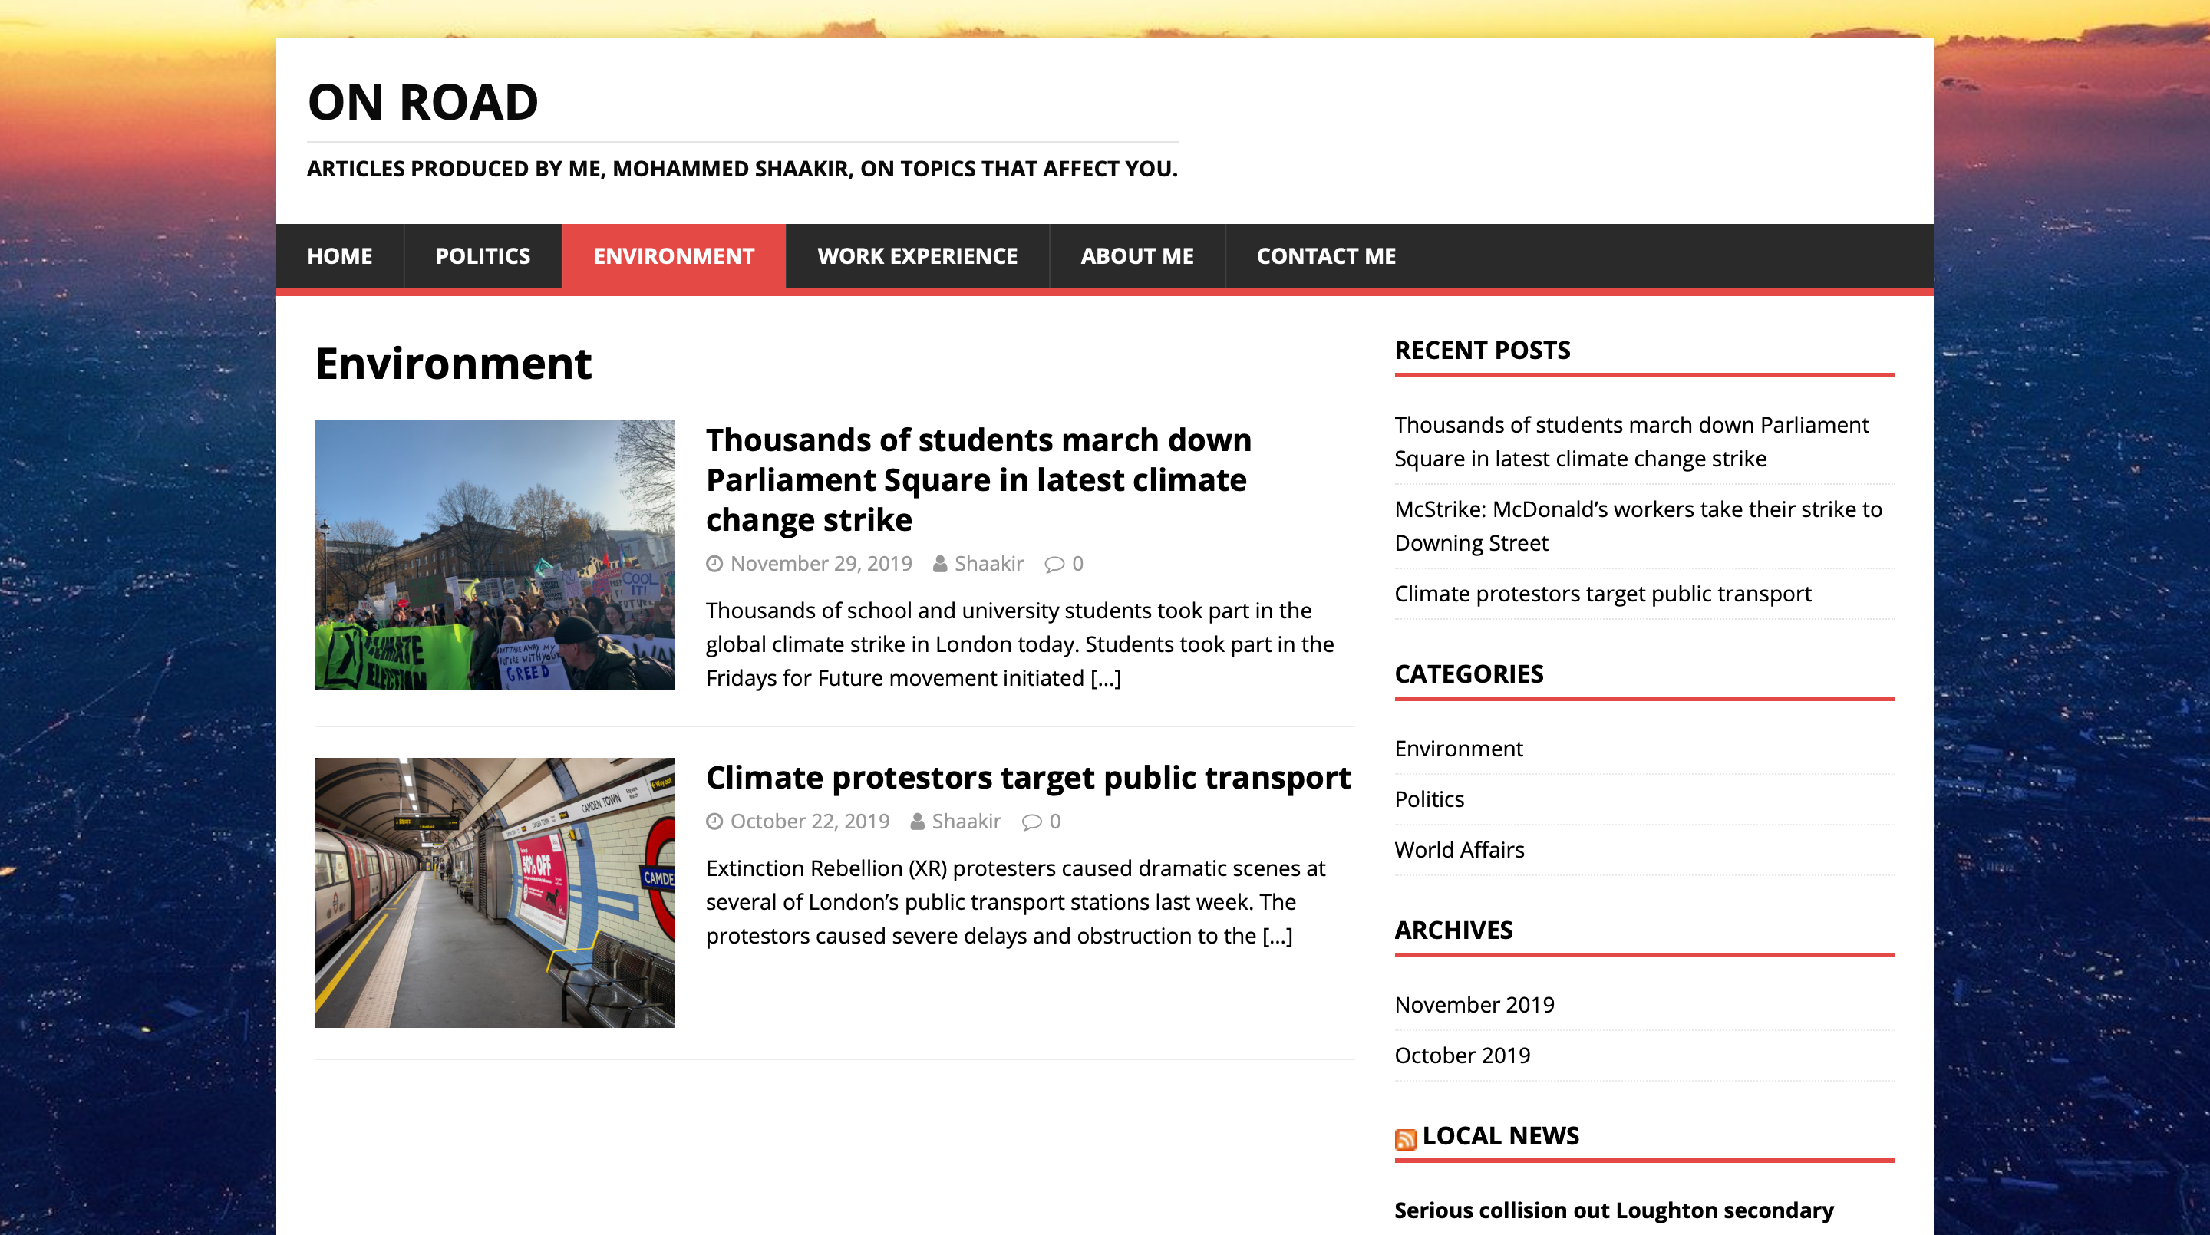
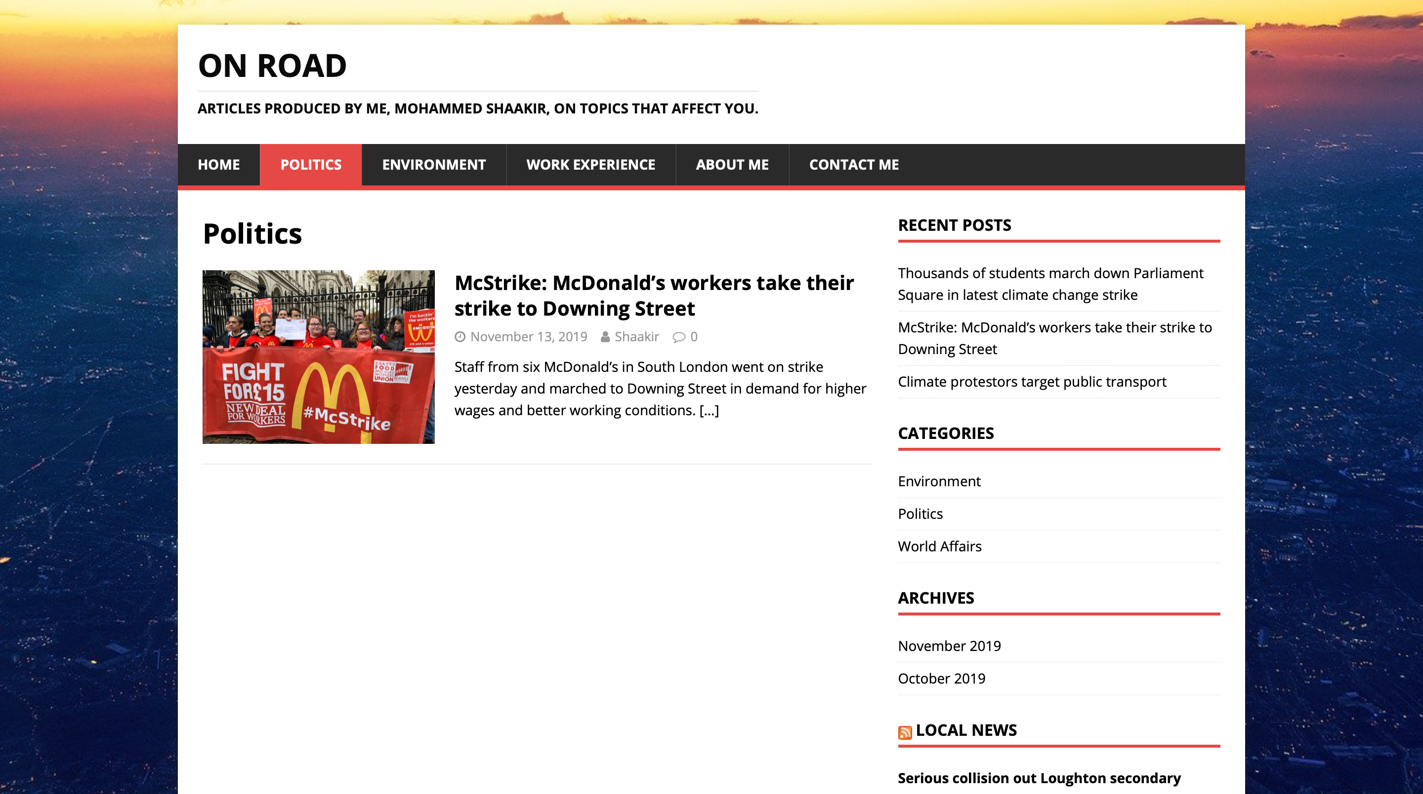
Notes:
Examples of what the navigation bar pages show.

Slide 5
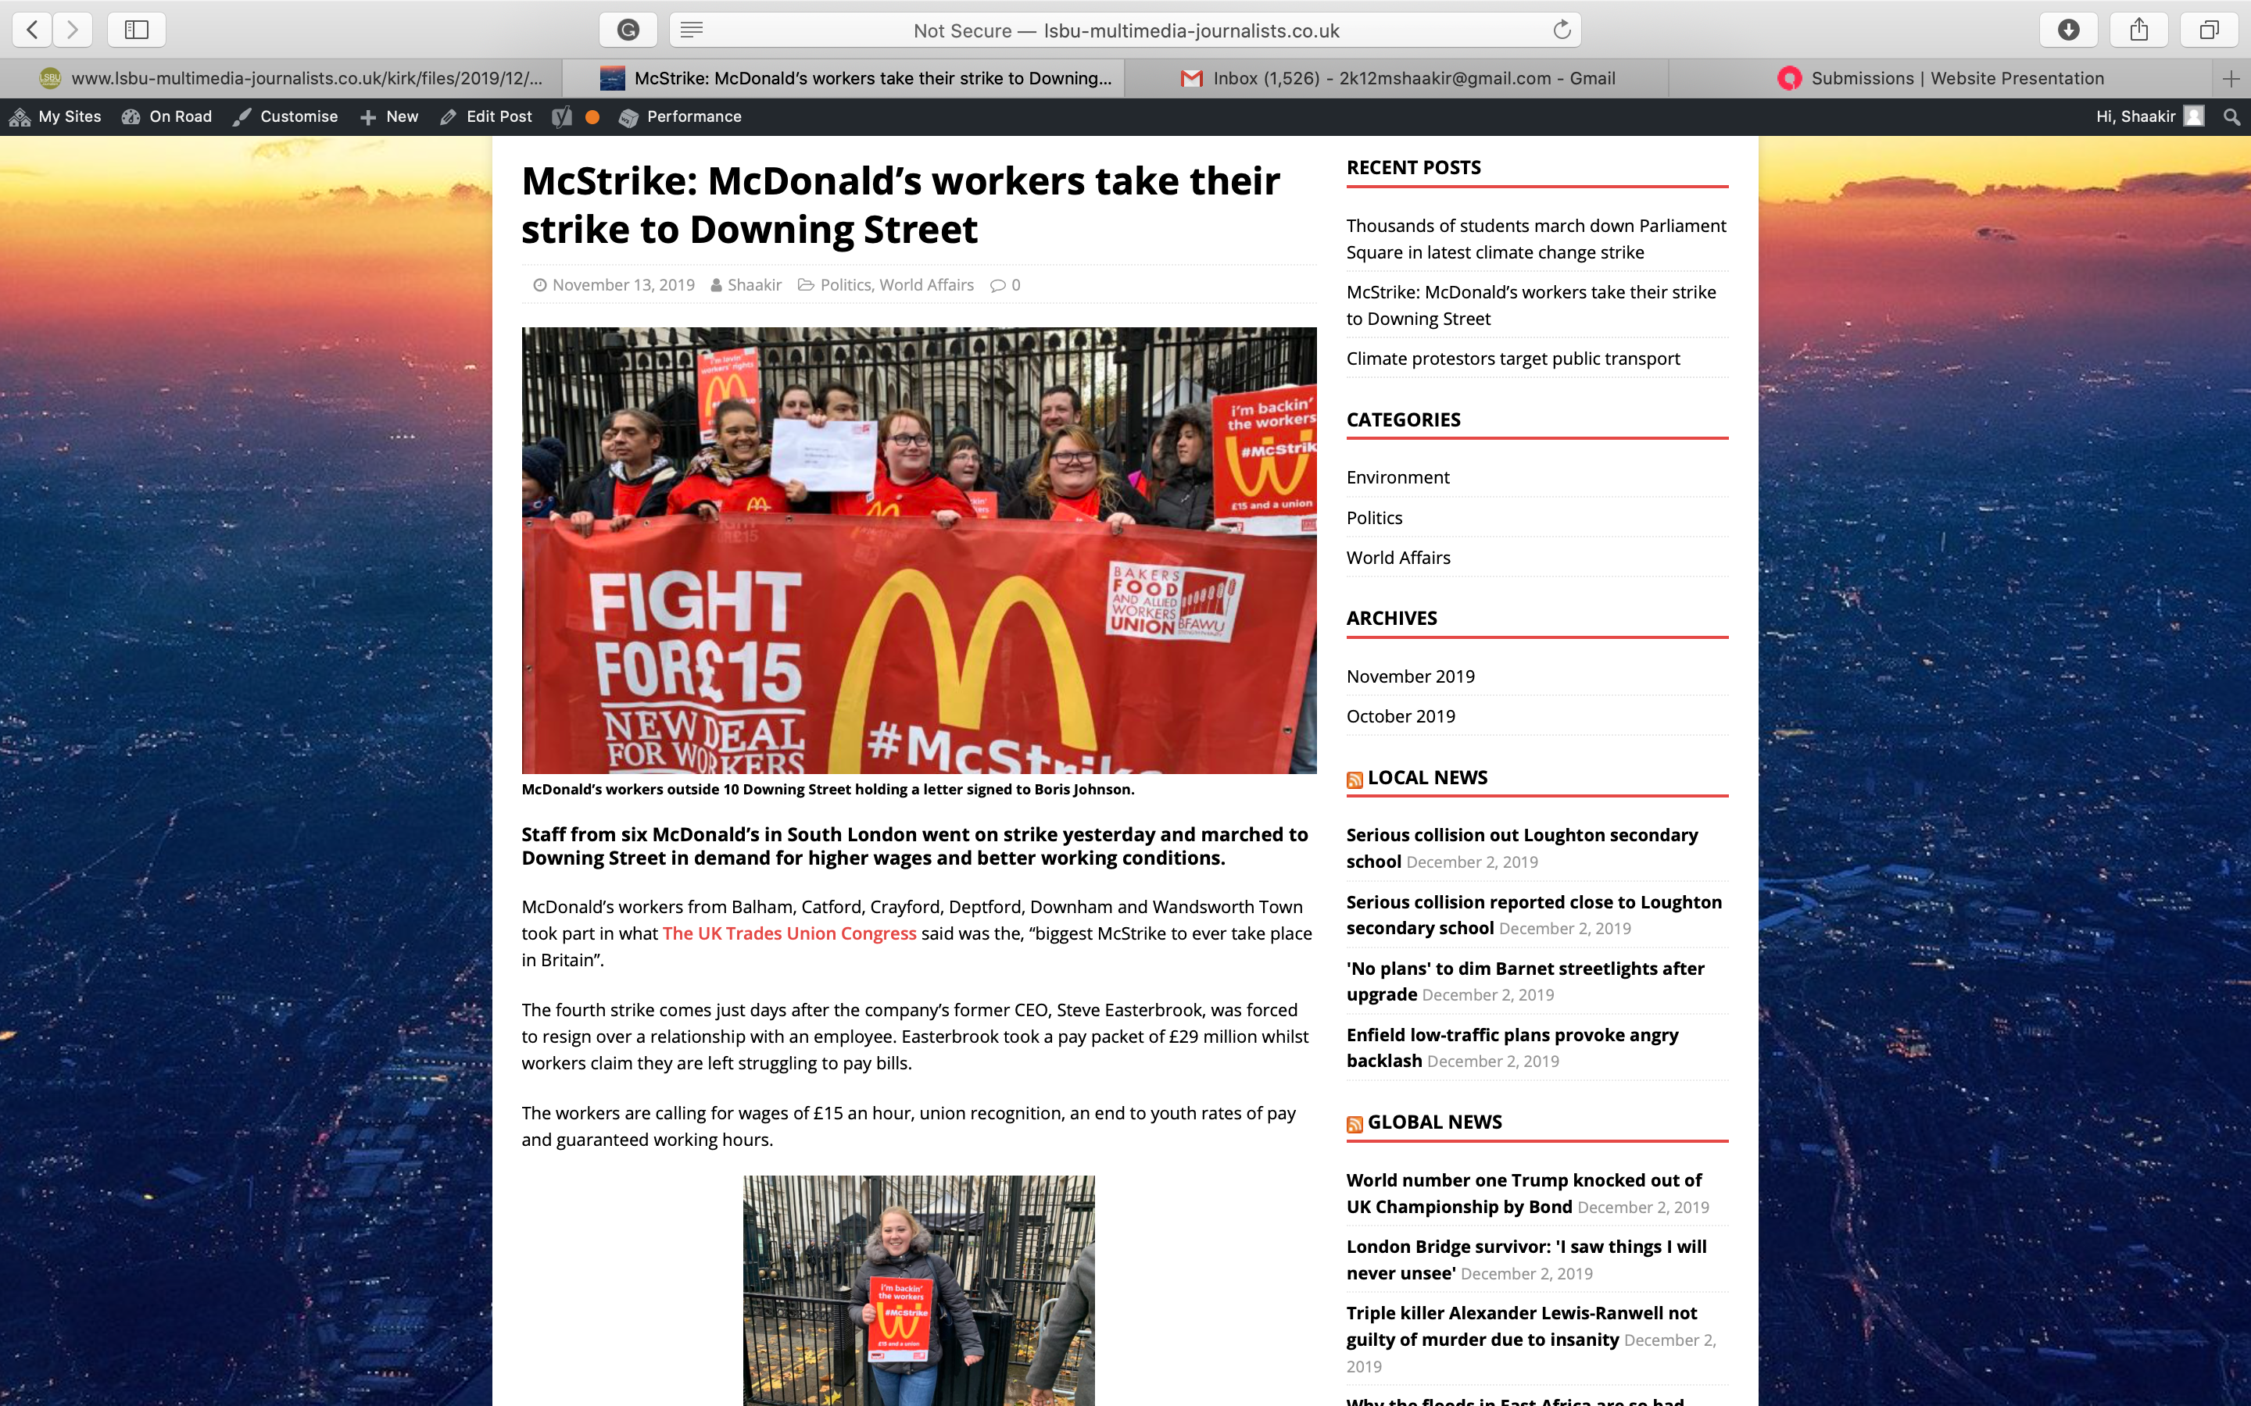
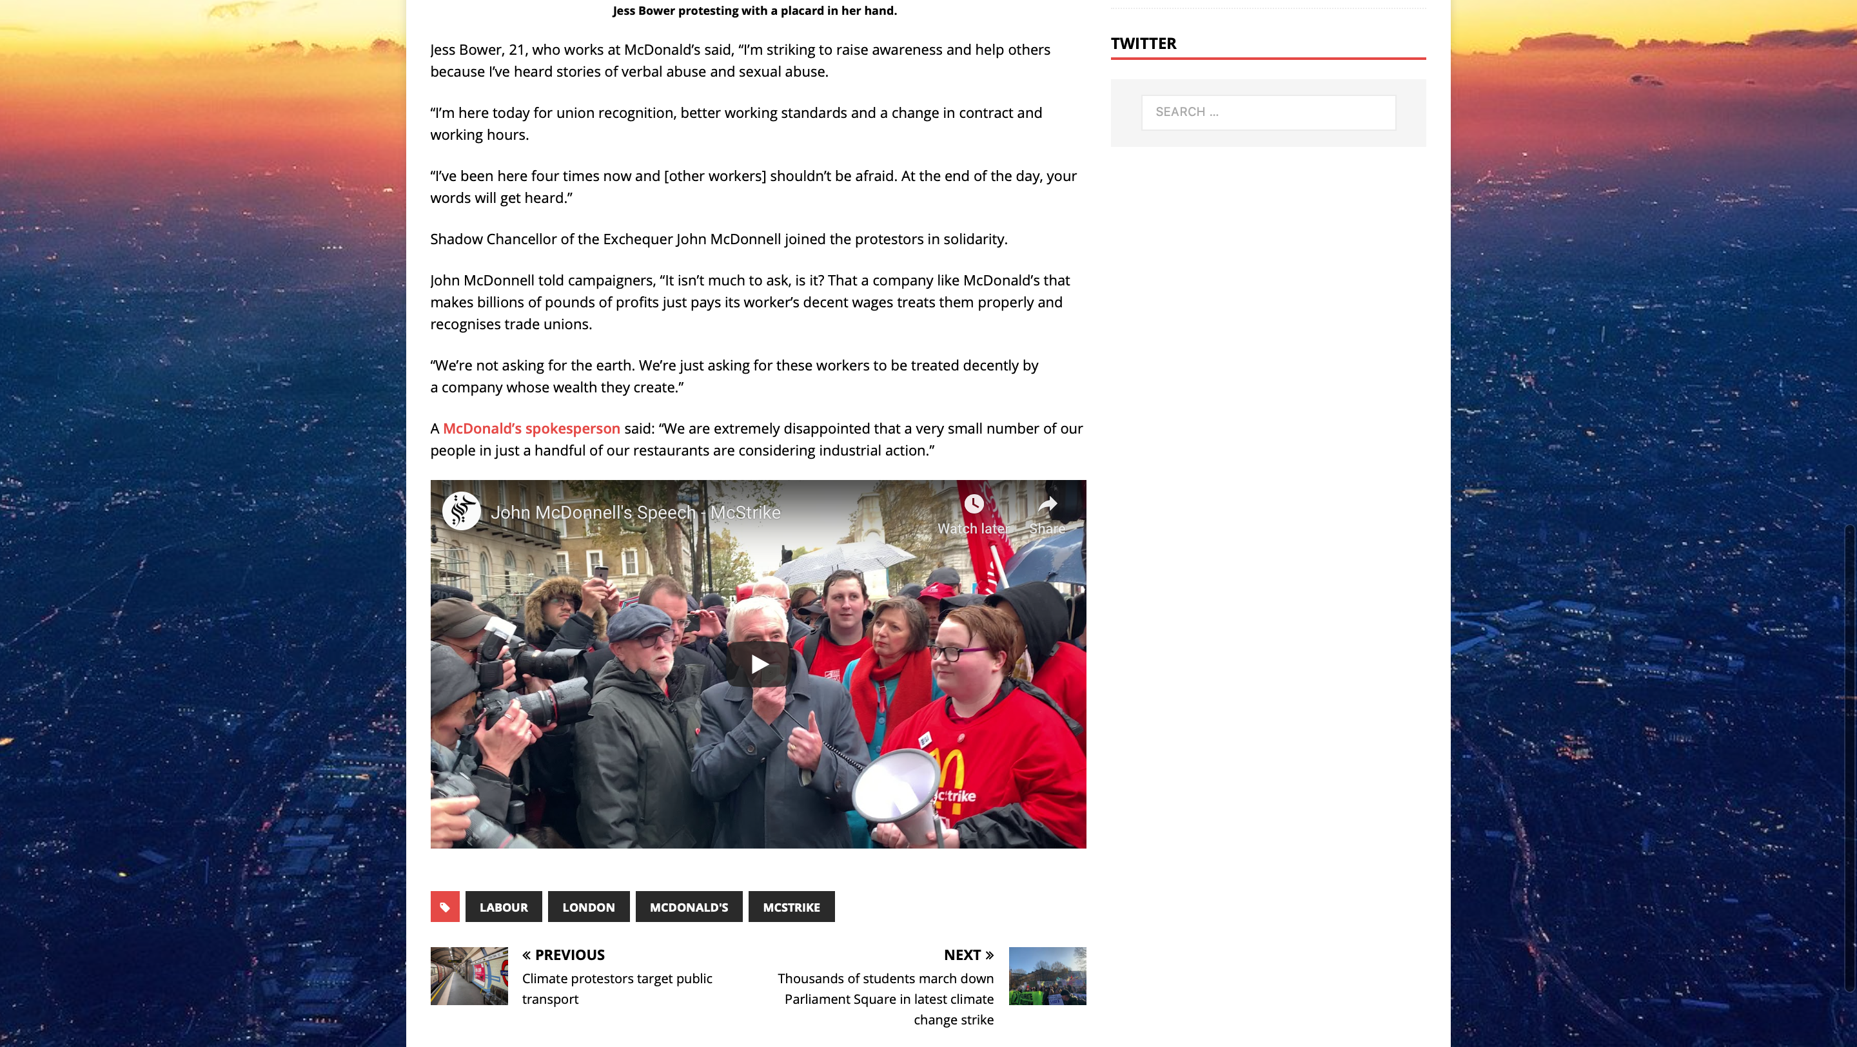
Headline
Featured image
An external link
Embedded video
Introduction
Tags
Notes:
These are some things I’ve done to increase SEO
Headline: The headline includes keywords and phrases which increase the SEO
Introduction: The intro for the article also includes many keywords so it’s easier for Google’s algorithm to pick up on it. Also it summarizes the article in a concise manner.
Featured image: The image has an Alt text which increases SEO and it has a clear caption, so readers know what is happening. All the images in the article have this.
Tags: for this article I used these four tags because 1. John McDonnell is an MP for the Labour Party. 2. the location is London. 3. McDonald’s because the strike was held by McDonald’s workers due to it’s awful working conditions. 4. McStrike because the strike was called McStrike.
External link: I’ve added an external link to the statement made by the McDonald’s spokesperson.
Embedded video: The video makes the article more engaging and shows the different forms of multimedia being used.

Slide 6
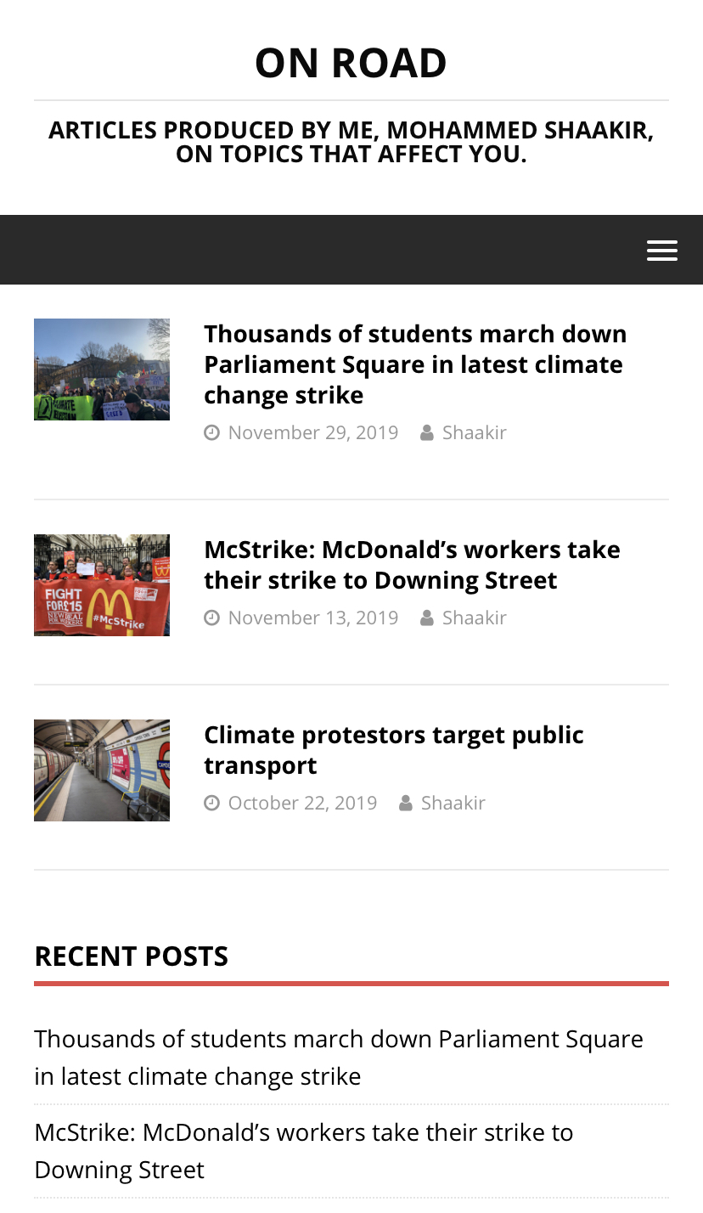
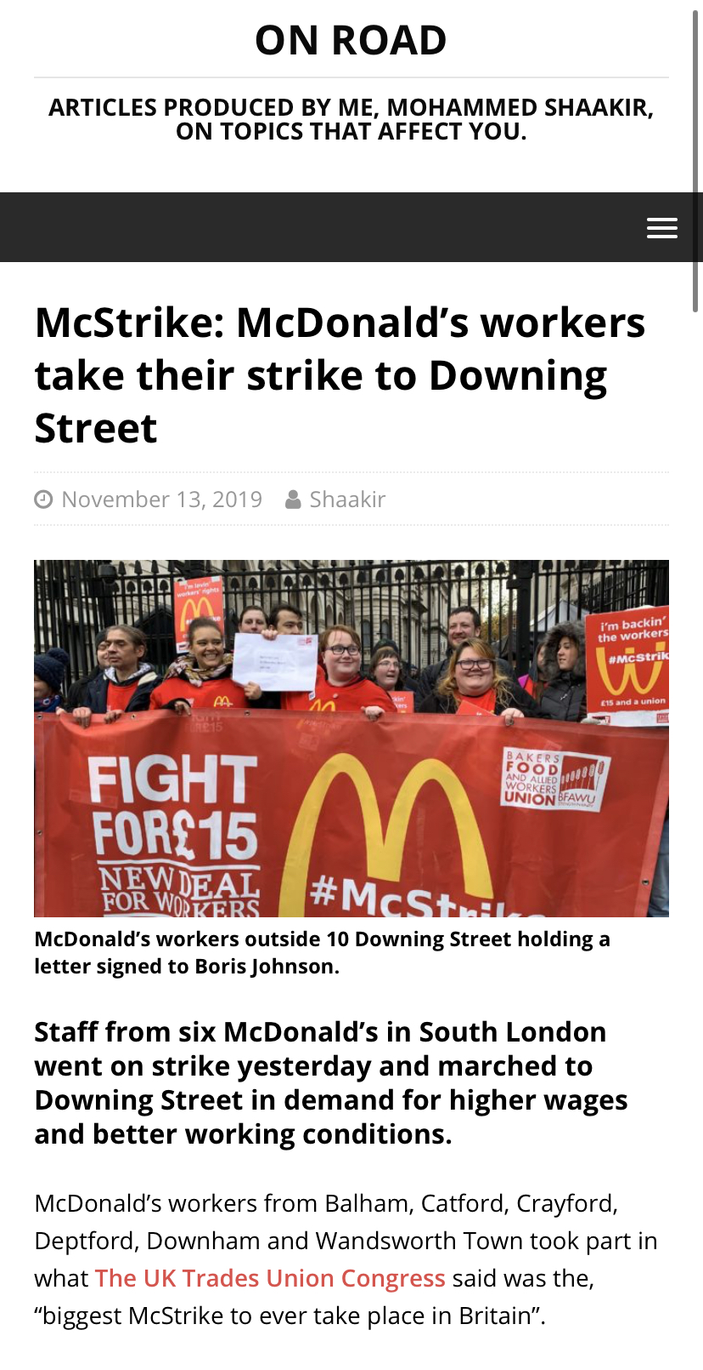
Most recent posts at the top
Images automatically resized
Notes:
IOS compatibility:
It’s very mobile friendly. The images have resized for the article. The menu bar has resized and works well with a mobile.

Slide 7
Improvements
Improve the SEO
Add a Twitter widget
Change location of widgets
Create a logo
Notes:
Improvements:
The SEO in the articles is currently at ’ok’ and I want to improve this to ‘good’. I would do this by changing the alt tags on the images and using Yoast to help me find better keywords and update my website refularly.
I need to work with Vanessa because I am having problems and I need to add a social media widget.
I might change the location of some of the widgets because currently they’re all on the sidebar so I might move some to the footer.
I might also create a logo to make the website look more professional and therefore increase the traffic.
Another thing I just noticed is that I will probably get rid of the ‘Category’ widget as the categories are visible in the menu bar.

