Slide 1
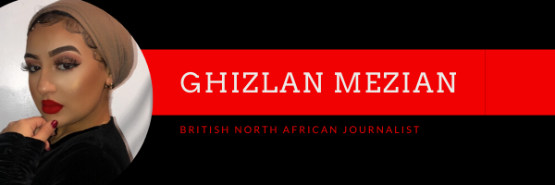
My WordPress Site
Ghizlan Mezian

Slide 2
Header
This is my Website Header which I created using the website Canva. I decided to use the colour scheme Red, Black, and White to illustrate a modern and sophisticated feel to my site. The colours I selected are Bold and I decided to complement my chosen colour scheme with a black bordered background to make my layout look neater and captivate my readers attention. I decided to abstain from using a pictured background as it could distract my audience and bring an element of playfulness to my site which I do not yet want to establish.
Menu
This is a Primary Menu where some items such as News, Blog and About Me also have sub-menu items that are displayed in a drop-down menu list. For example, the drop-down items within the Blog consists of categories such as Travel, Beauty, Modest Fashion and Food. This ensures that navigation is easier for readers and gives my website more structure and increases feasibility of accessing my posts.

Slide 3
Homepage
Currently my homepage displays all my latest posts on the left. Beside the preview of my articles are my featured images. In the future while developing my site I want to have a slideshow of the most popular post that has received the most views.
To ensure that I cause traffic to my site I have shared my hompage URL onto my LinkedIn profile and have had a few reshares already and I have also shared my URL onto my instagram bio.​

Slide 4
Sidebar Website Widgets
I have a categories widget on my website which will enable my audience and readers to navigate easily through the posts which are most relevant to them.
Another Widget is my Recent Posts which are chronologically ordered from oldest to newest. This lets readers know what the latest news is.
This is the MH slider widget which is my favorite. It complements my theme and looks like a mini slideshow of all of my latest posts with their featured image.
This Calendar Widget is beneficial for myself and readers who can locate my posts based off the month or date they were posted.

Slide 5
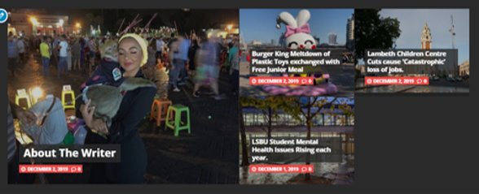
Footer Website Widget
This widget is at the bottom of my homepage which reveals my top posts in a stacked collage layout. This again is a feature to make my page a sticky website so that readers feel compelled to stay on my page for longer and browse through more of my content.

Slide 6
My Website Active Plugins
The first plugin that I activated is the BAWS post views count plugin which will enable me to keep track of how many people have viewed my site and specific posts.
The second plugin that I activated is the Yet Another Post Plugin which means that the ads on my website will have a customizable and correlating algorithm so that my readers are thoroughly maintained with a set order and website that meets their needs.

Slide 7
Who are my Reader?
Target Audience
Male and Females
Ages 16-35
Interested in Global and Local News
My Instagram Audience

