Slide 1
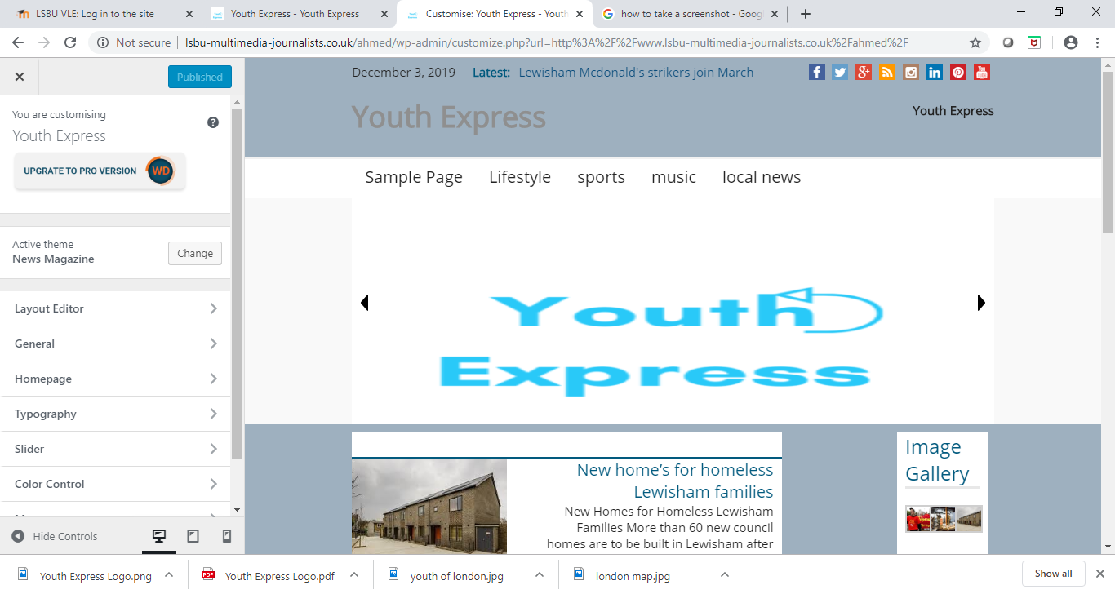
My website
My websites title is Youth Express. I decided to call it this because my target audience for my website is the youth of London.
I thought the title would be a good way of catching the eyes of my target audience and I also added a logo to go with my websites title. The logo is simple and easy to remember.
I chose the design named ‘news magazine’ because the layout was very simple and easy to navigate. I chose the colour grey as my background colour to match the blue font of my logo design.
Under my menus I have sliding images that represent my website ( London map, my logo and image of youth)
I added menus such as Lifestyle, sports and music so that the readers can have a variety of content. There is also a local news categories where my three stories were published.
http://www.lsbu-multimedia-journalists.co.uk/ahmed/

Slide 2
What I like about my website
One thing I like about my website is the layout. It is very easy to navigate through the website and find whatever you are looking for.
It has a variety of different categories to provide you with whatever content you are looking for whether it be sports, music, lifestyle etc
I activated a plugin which allows the posts the be liked or disliked by the readers which allows me to get feedback.
I used a primary widget to add an image gallery that displays the images used from my news stories and readers can also go here for future images that may be added.

Slide 3
What I would like to improve
One thing I would like to improve on my website is the variety of content. I would like to publish a news story for every category.
I also would like to add a bit more colour to my website to make it more appealing and eye catching to my target audience.
I also would like to use more widgets and plugins.
I also would like to have added some social media feeds, like twitter, Facebook or Instagram.
I would also like to improve my logo, to make it a bit more interesting and rememberable.
I also would like to add more menus to cater to a wider audience of readers.
I also would like to add a description of my website to let the readers know what my website is about and what they could look forward to.

