Slide 1
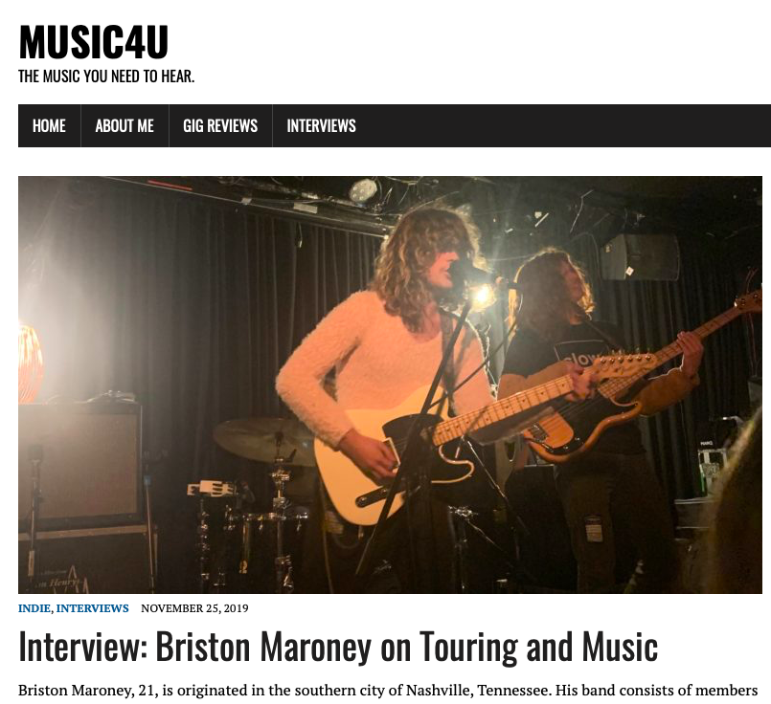
MUSIC4U
A presentation on my website.

Slide 2
I chose the title ‘Music4U’ for my website as I think the use of modern abbreviations make the title memorable. The title also clearly shows what my site is about.
I decided to base my website completely on music as I want to become a music journalist myself and I feel I can write a wide range of posts based on music.
My tagline hopefully encourages visitors to take interest in the different music and artists I write about.
NAME AND TAGLINE

Slide 3
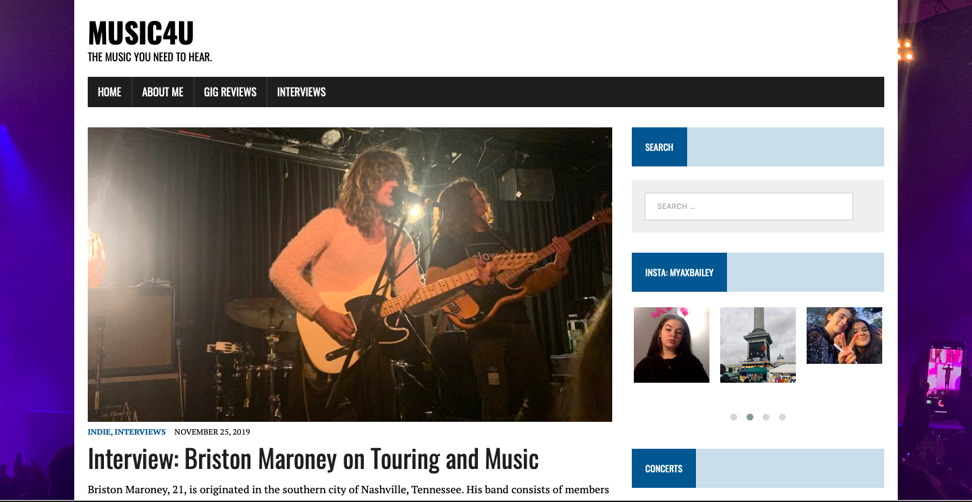
THEME & DESIGN
I decided to choose the theme ‘MH Newsdesk lite’ for my site as I felt the theme is simple and easy to navigate for visitors.
It also looks more like a blog, which I was aiming for.
My background image is a photo from a concert.
I chose this image as it relates to what all my posts will be about, which is music.
The photo is colourful and bright, this means it stands out, especially in contrast to the other colours and features I have on my website.
I have not added a logo / header image as I wanted my site to be more minimalistic and I felt the pictures I tried to add didn’t look right.

Slide 4
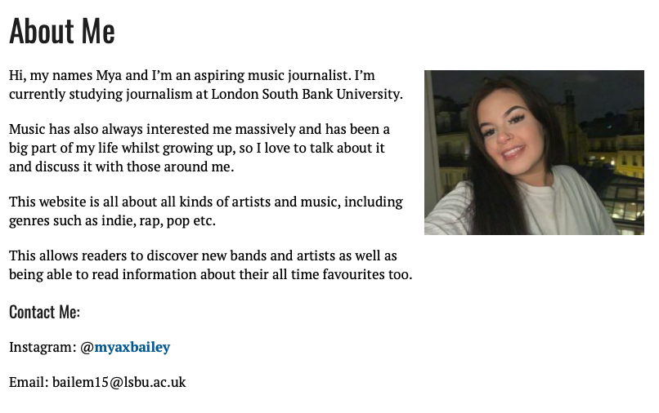
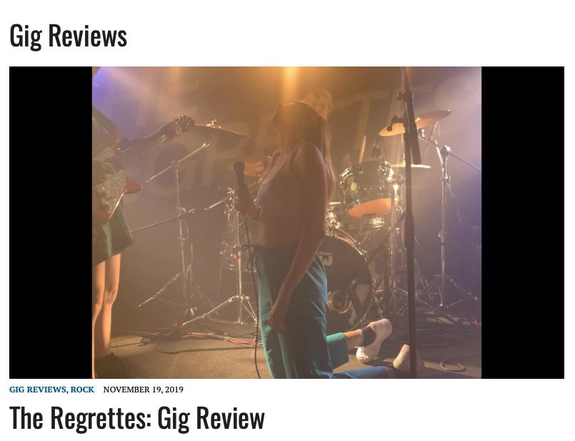
MENU
My menu is located at the top of all pages on my website. The menu ensures that people can navigate my site and easily choose where they would like to visit.
The ‘Home’ button takes you to the home page which includes all my posts in reverse order.
The ‘About Me’ page includes a short description on myself as well as a photo and contact details.
The buttons ‘Gig Reviews’, ‘Interviews’ and ‘News’ take you to different posts under those categories. These categories are most common on my website.

Slide 5
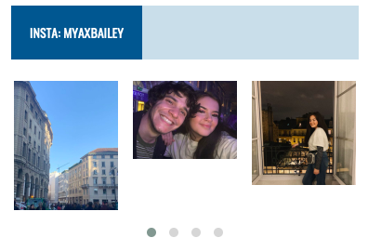
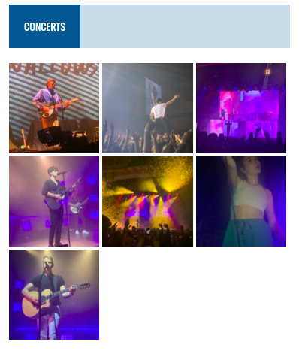
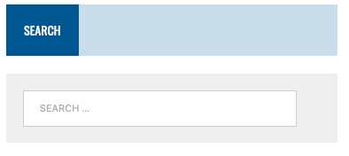
WIDGETS & SIDEBAR
On my sidebar I have included three widgets.
I have a gallery option which I’ve decided to use for photos of different concerts which link to the content I post.
I added my Instagram to allow visitors to see my personal content and go to my Instagram page if they wish
I also added a search bar so visitors could choose to look for certain posts. E.g. on a certain artist / band.

Slide 6
TARGET AUDIENCE & IMPROVEMENTS
My target audience will be people that are very interested in music, different artists and musicians. Over time I’m hoping to include a wide range of genres in my posts so I can appeal to a range of people.
I’m also hoping my website can influence and expand my visitor's interests in music, so they’re able to discover new artists and music events by the posts I have published.
I want to improve my website by posting more content and maybe allowing there to be a place for my readers to communicate with each other and so they can share criticism with me also.

