Slide 1
Professional Identity
WWW.moonasworld.uk

Slide 2
Identify companies you would like to work for
BBC three documentaries, Fusion group and channel 4 documentaries
I have always been highly interested in documentaries, because they greatly influence people’s perceptions and actions in society. Watching documentaries have brought light to subjects that have been either avoided or haven’t been discovered, and I want to be part of this sector, in order to be able to make a difference and give voice to those who haven’t got the power to unveil the truth.
Especially FusionTv as they connect to the younger generation through their documentaries.

Slide 3
How my website will prepare me for getting a job in the sector I want
I wanted my website to show what sector of journalism I am really interested in, which is making documentaries, whether its about crime or lifestyle.
My site will be influenced by louis theroux who is a documentary maker and his website showcases his work in a very simple yet detailed manner.
My site will also be completely Mobile friendly.

Slide 4
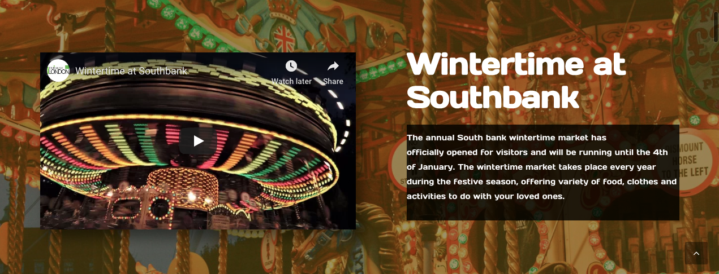
How my website will prepare me for getting a job in the sector I want
On work section
On Video section

Slide 5
Internships/placements so far - what roles you have taken on, what you have learnt, how these internships have helped prepare you for the job sector
PR and Marketing at Small steps project
At small steps project we make short films and organise campaigns, such as celebrity shoe auctions. This is in a bid to help spread awareness for global situations such as young kids living on dumpsites in countries like Cambodia. My job as part of team, varied from helping create documentaries, taking pictures and posting on social media, to finding other organisations to collaborate with.

Slide 6
internships/placements so far - what roles you have taken on, what you have learnt, how these internships have helped prepare you for the job sector
The charity was founded by former celebrity journalist Amy Hanson, who now heads the PR and press department.
Working alongside Amy has given me more of an insight of the journalistic world, as before any video, picture or post was to be posted it had to be checked and approved by her first.
I was able to shadow Amy throughout the day and see how she handled tasks and what she did; I was then given the same tasks to do myself after learning from her.
I have gained first hand experience of how the world of social media works and how it can be used to make a change

Slide 7
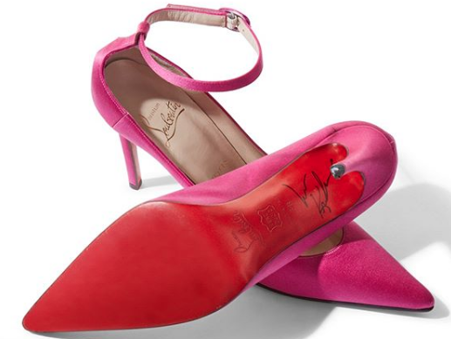
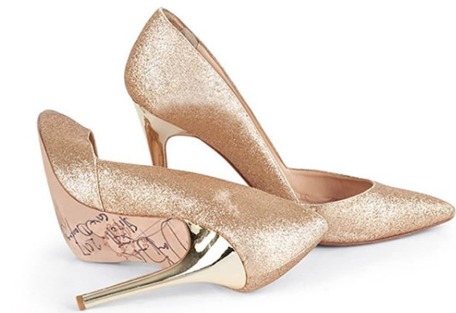
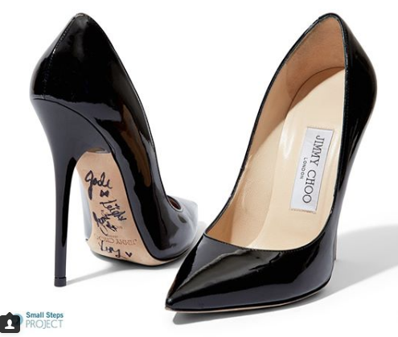
Small Steps project
https://www.instagram.com/smallstepsproject/?hl=en
http://www.smallstepsproject.org/films/
These are some of the pictures I have taken for small steps

Slide 8
How your CV reflects your skills/work experience
I have tried to showcase my personality and creativity in my cv by creating it in a way which has enabled to fit in as much information about my skills, experience, and assets as I could, at the same time looking fun for the eyes of the employer.

Slide 9
Explain your plan of action on graduation - what does your future look like in the next 2 years?
In the next two years I aim to be able to take my website further and develop it, as well as work and shadow a documentary maker, and slowly be on the verge of creating a documentary about a story I am passionate about.
I want to start creating my own small documentaries which I can upload on YouTube and slowly join bigger documentary projects.
My aim is work for BBC 3’s real stories and investigate stories and be able to present it.

